Slide 1
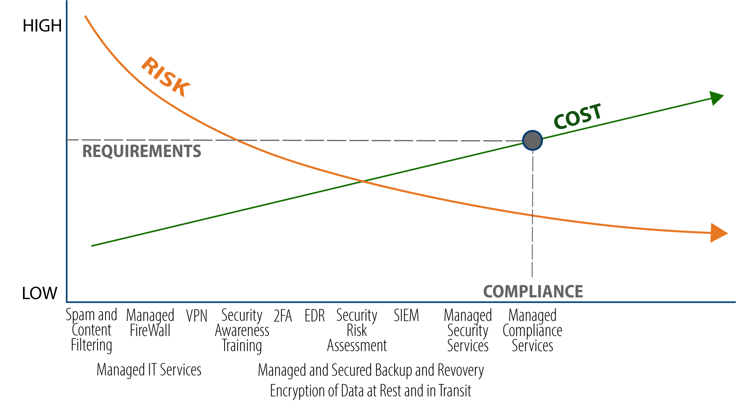
Risk – Cost – Benefit Diagram
Notes:
The requirements are higher for businesses under compliance – OR – doing business with another business under compliance (Business Associate Agreement)
MOVE the RED Star along the RISK line to your RISK TOLERANCE. Every business owner has a risk tolerance – some high, some low. Where do you fall?
AME believes there is a balance where the cost has a high ROI based on the impact the solution has on the security risk, the market maturity of the solutions and what is considered reasonable / best practice today.
For those under compliance, you will need at least - SRA annually, ongoing vulnerability scans, EDR, SIEM, Managed Security Services (need for someone to manage your specialized security needs, monitoring SIEM, Scans, etc.)

